Slide 1
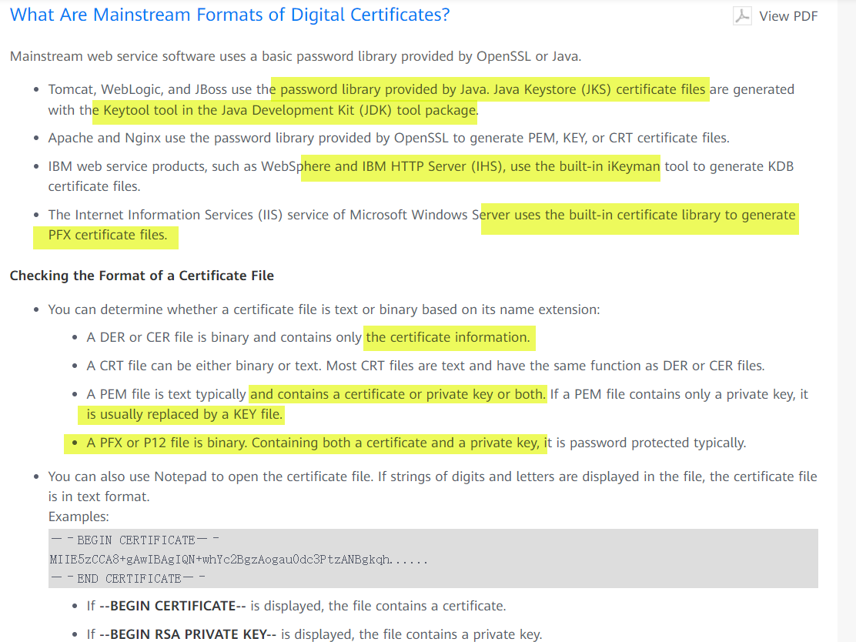
Notes:
https://support.huaweicloud.com/en-us/ccm_faq/ccm_01_0054.html
https://www.digitalocean.com/community/tutorials/openssl-essentials-working-with-ssl-certificates-private-keys-and-csrs
https://www.digitalocean.com/community/tutorials/java-keytool-essentials-working-with-java-keystores

Slide 2
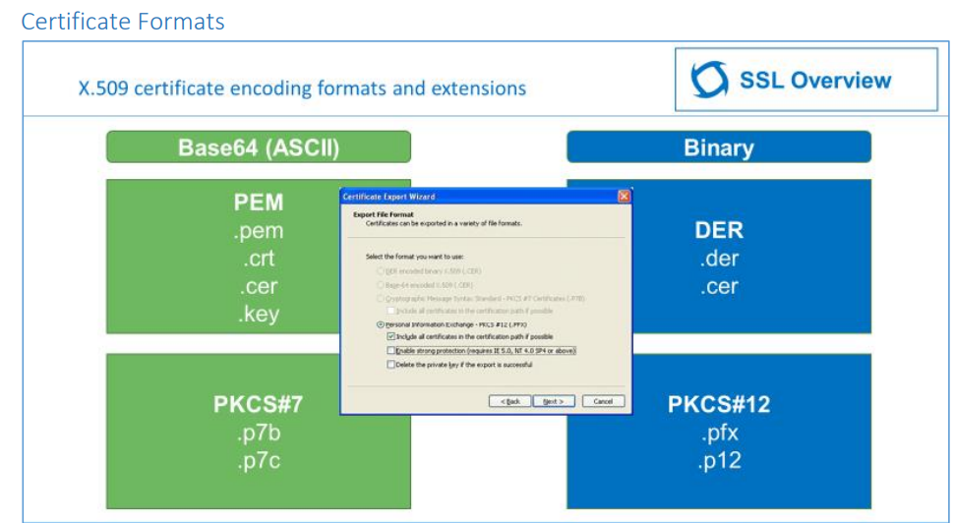
Notes:
https://www.digicert.com/content/dam/digicert/pdfs/ssl-tls-best-practice-workshop-student-guide-en.pdf

Slide 3
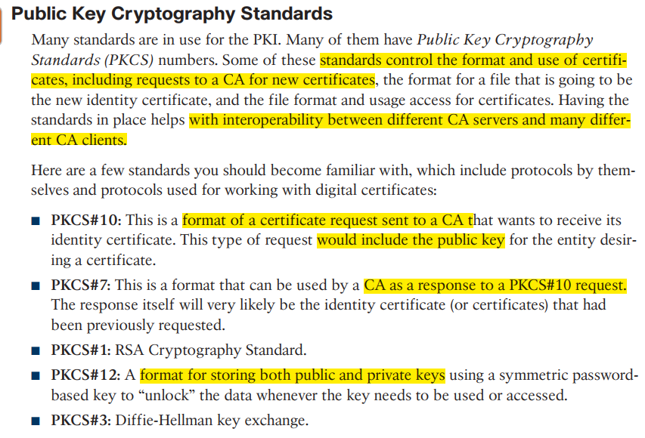
PKCS#7 lets you sign and encrypt generic data using X.509 certificates. Also PKCS#7 format can be used to store one or more certificates without private keys (private keys can be put as a data payload and encrypted this way).
PKCS#10 defines format for certificate requests.
PKCS#12 provides a container for one or several certificates with private keys
File Formats :
Privacy Enhanced Mail (PEM)
Text format. Base-64 encoded data with header and footer lines. Preferred format in OpenSSL and most software based on it (e.g. Apache mod_ssl, stunnel).
Distinguished Encoding Rules (DER)
Binary format. Preferred format in Windows environments. Also the official format for Internet download of certificates and CRLs.
PKCS#8 private keys
PKCS#10 CSRs
PKCS#7 bundles of two or more certificates ( Response to CSR)
PKCS#12 bundles of private key + certificate(s)

Slide 4
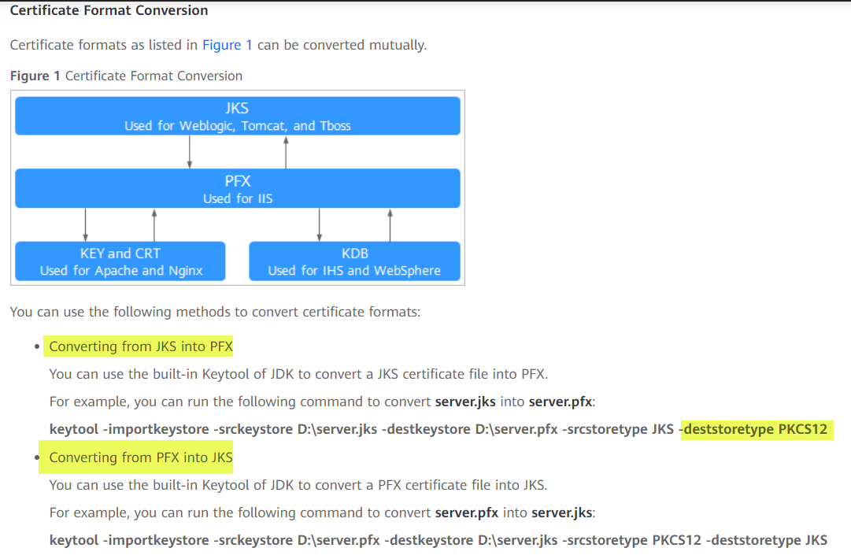
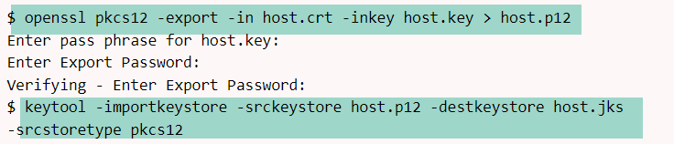

Slide 5
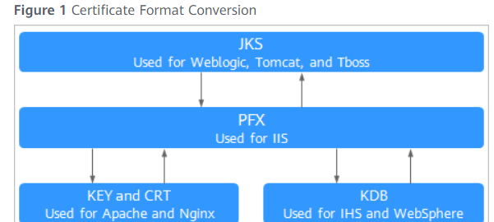
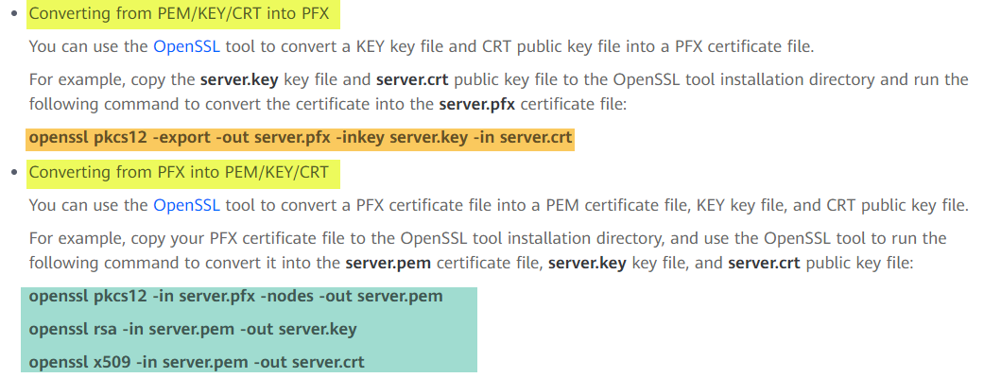

Slide 6
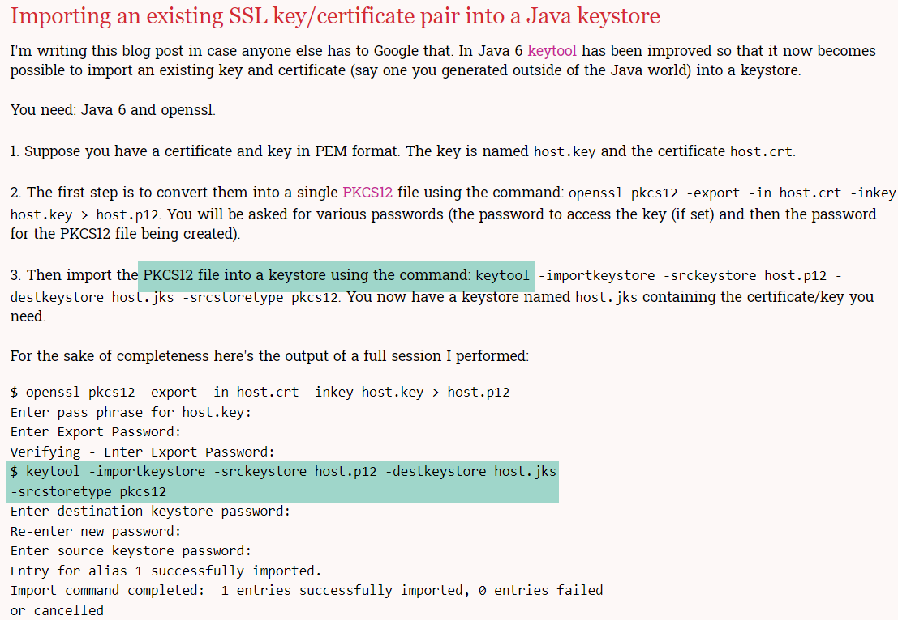

Slide 7
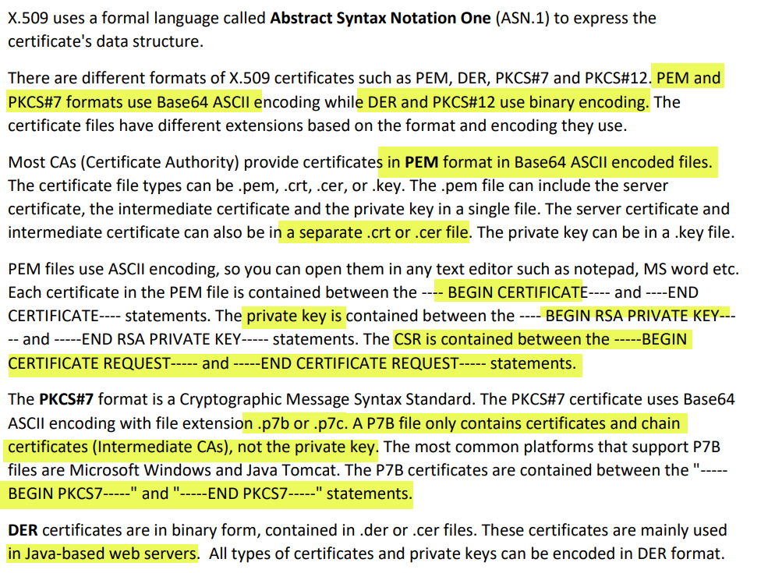

Slide 8
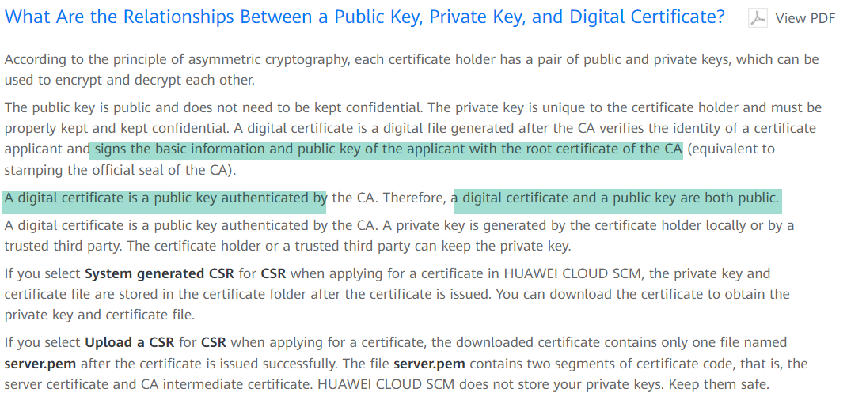

Slide 9
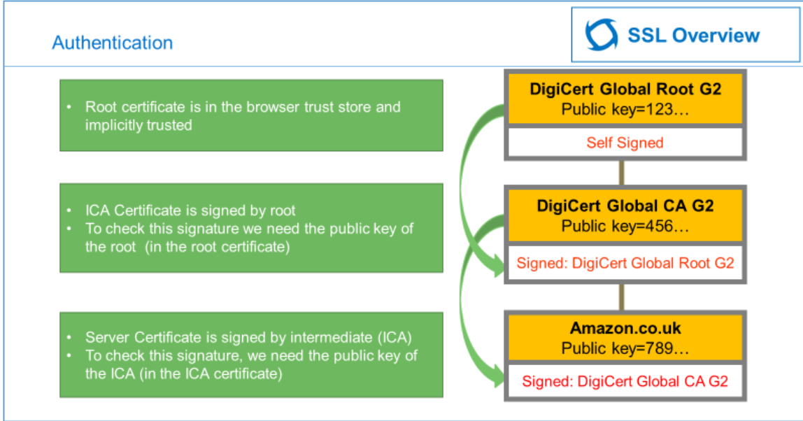
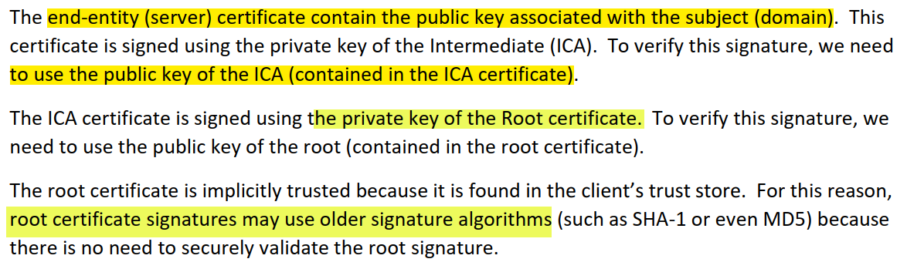

Slide 10
SSL/TLS Application Layer
Transport mode/IPSEC
Tunnel mode/IPSEC
Layer 2/MACSEC

Slide 11
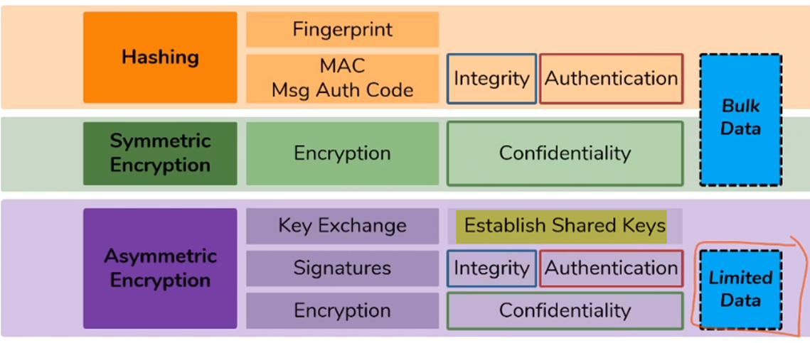
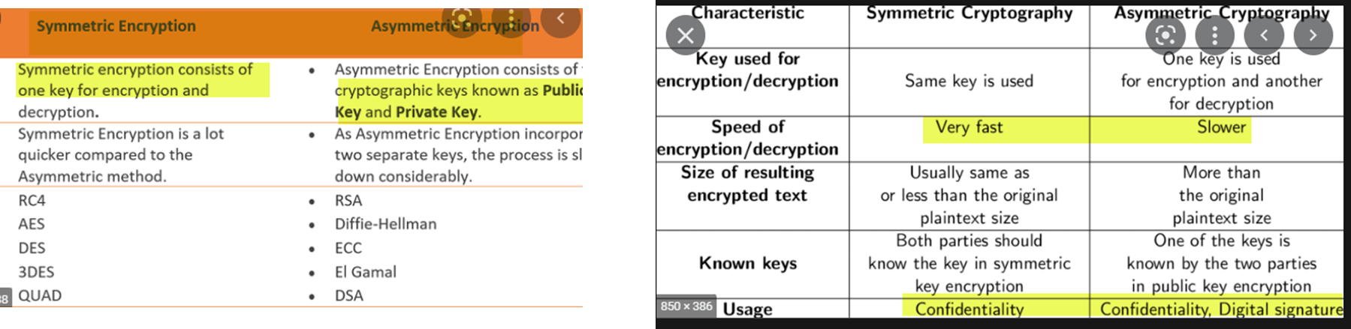

Slide 12
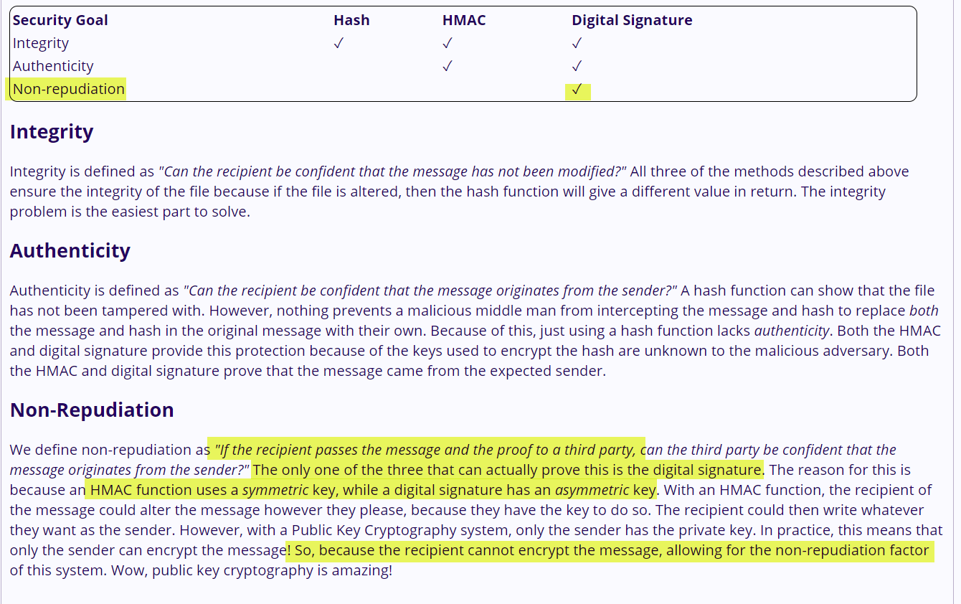

Slide 13
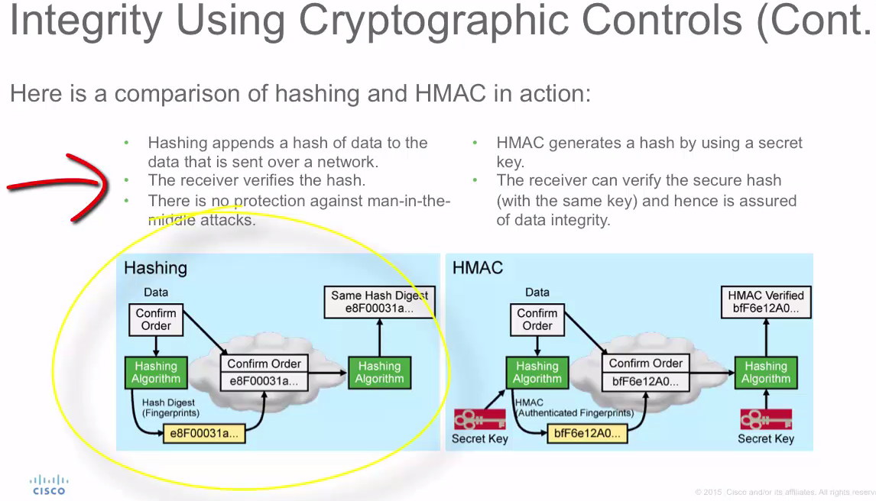

Slide 14
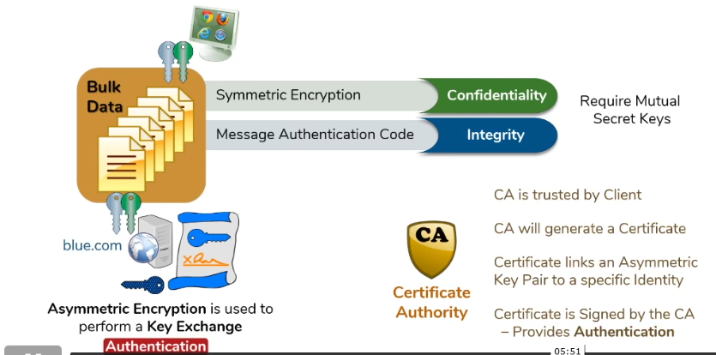
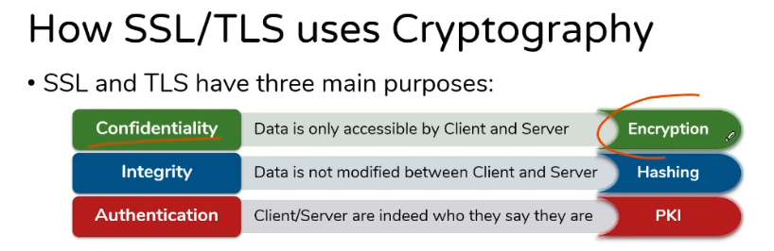

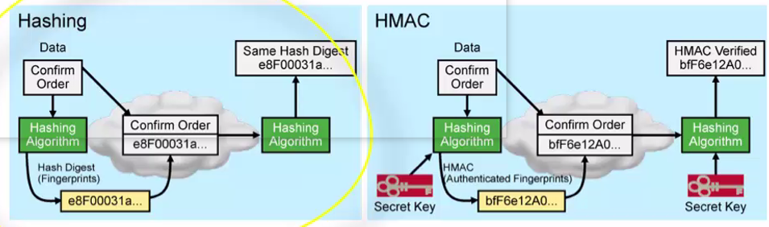

Slide 15
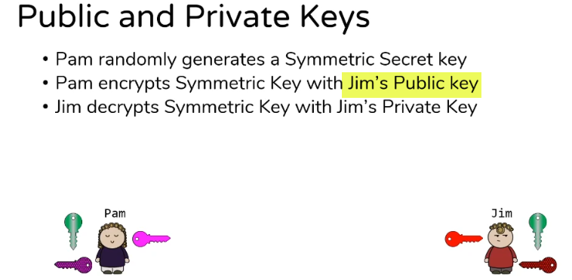
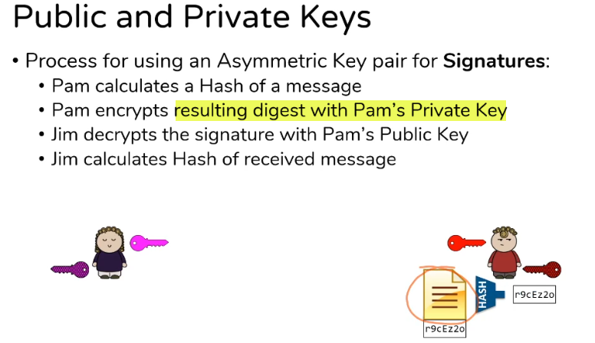
Encryption is done using receiver’s public key
Signature is done using sender’s private key
PAM
Message
Hash of Message
Encrypt Hash using PAM’s Private key
Note : Though Signature use Private Key ,you are not using to Encrypt the Whole Data but you are Encrypting Hash of the Data(Hash is Small representation of the data)
Message
Hash

Slide 16
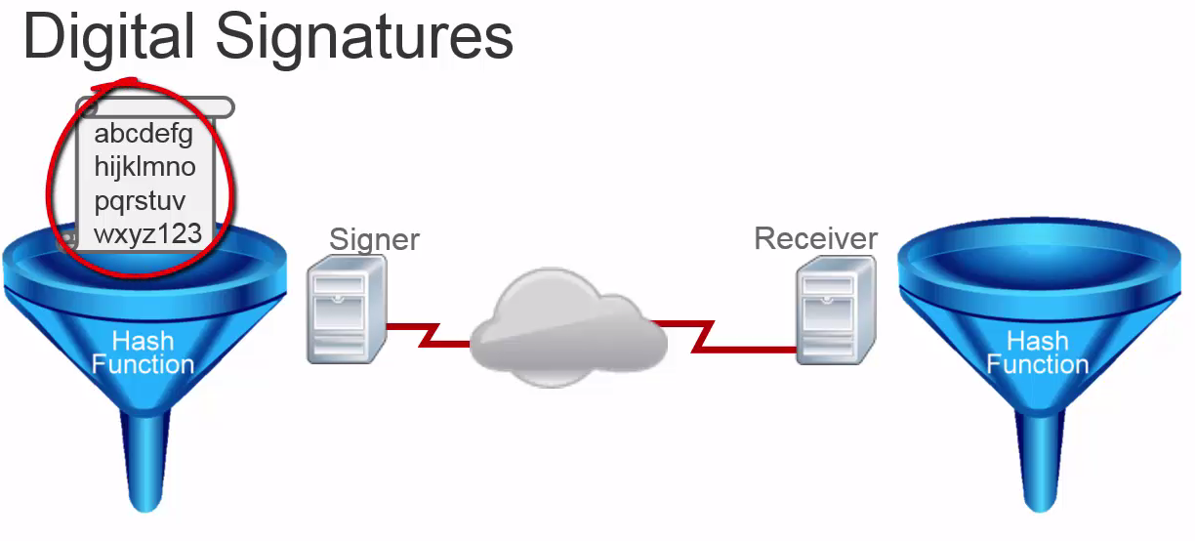
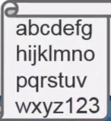

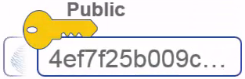
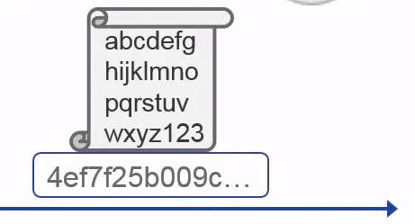


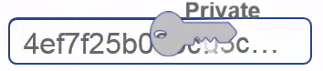
Digital Signature = Encrypted hash of data
Read Notes :
DATA
Encrypted Hash of DATA
Hash of DATA
+
Private key
DATA
Encrypted Hash of DATA
match
Notes:
1 Using Asymmetric Encryption can be used for authenticity of the Sender but it’s computationally expensive if you need to lot of redata .
Digital Signature solves that problem using hash + Asymmetric Encryption
As Above diagram shows :
1 Signer run the data through hash function & received hash is than encrypted with it’s private key ( we are encrypting the hash not the whole data so less computation) , Resulting signature we send with the original document.
2 On Receiver we run the data through hash function which gives the resulting hash (end with 003c) , at the same time we decrypt signature with Signer’s public key & if result’s match than we can verify the authenticity .
Digital Signature :
1 Origin Authentication ( Only signer’s pubic key can decrypt the signature encrypted by signer private key)
2 Data Integrity : ( if finger print match so data has not been altered)
3 Non-repudiation : ( Only signer’s private key produce the signature , can not deny that

Slide 17
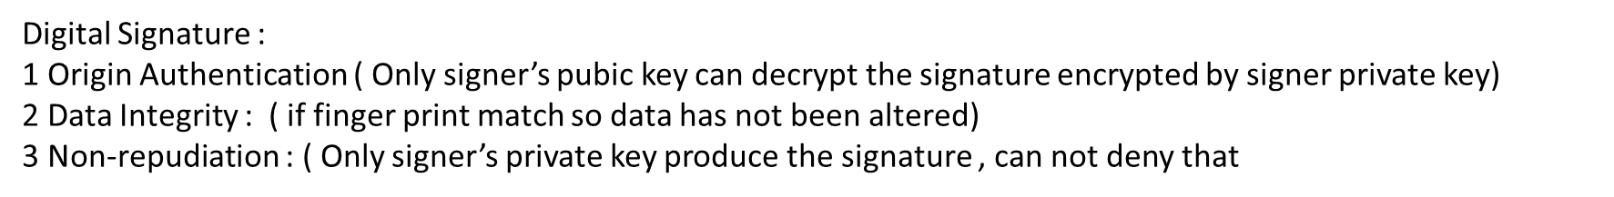
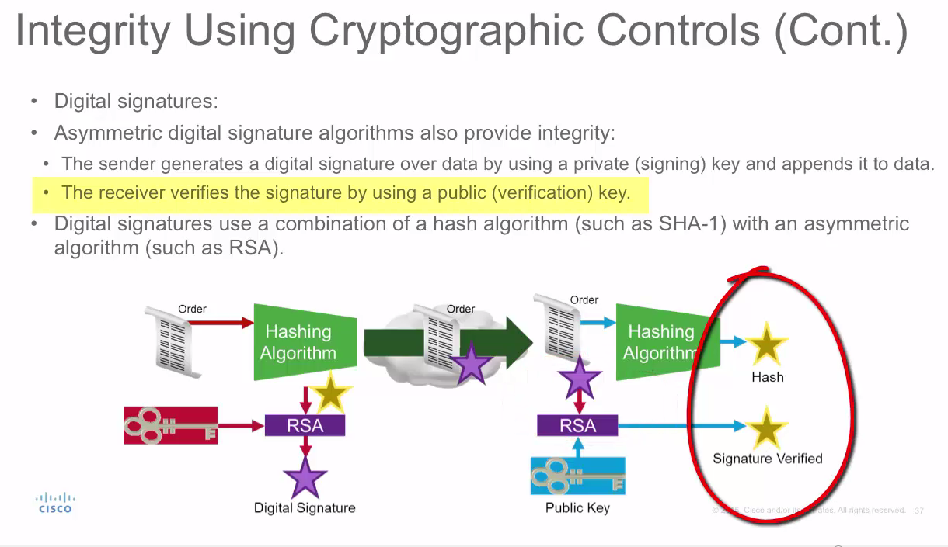

Slide 18
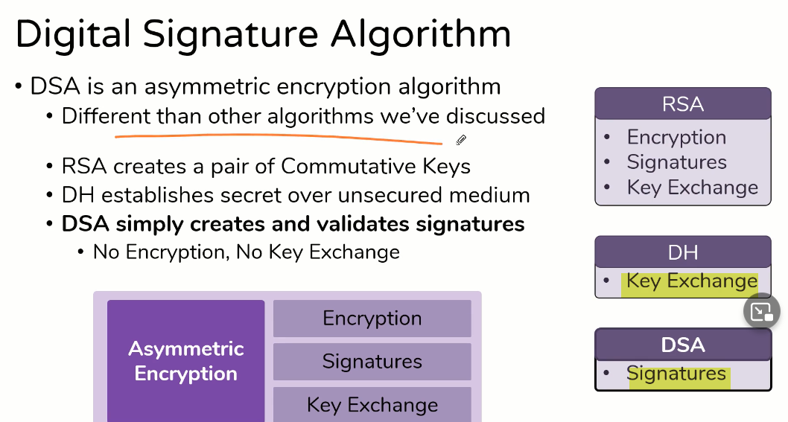
Asymmetric Cryptography

Slide 19
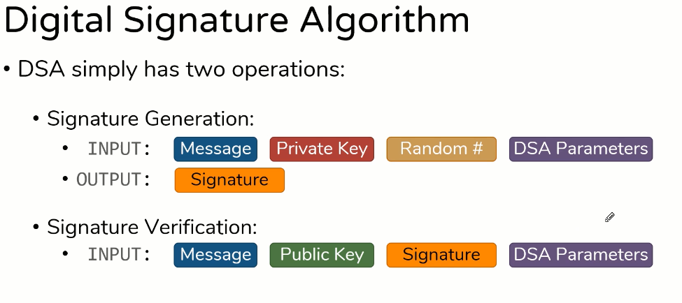
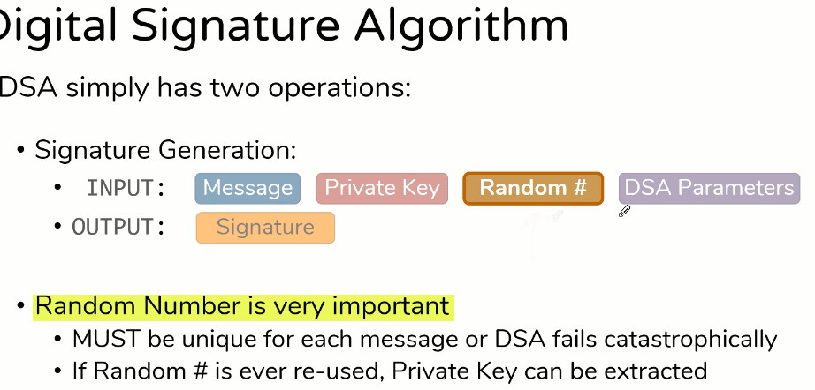

Slide 20
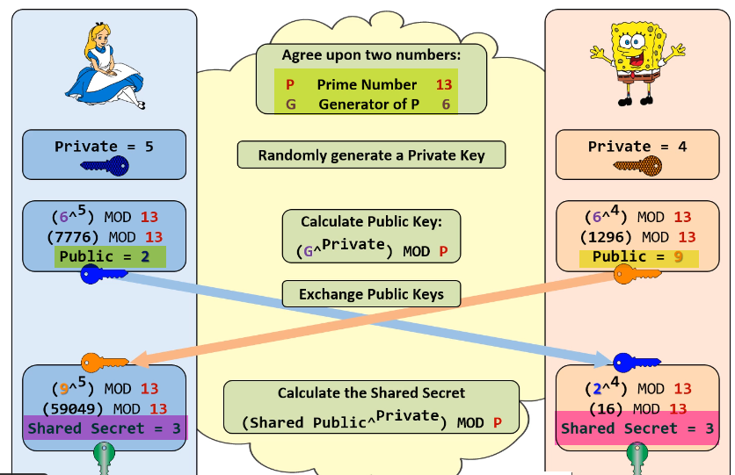
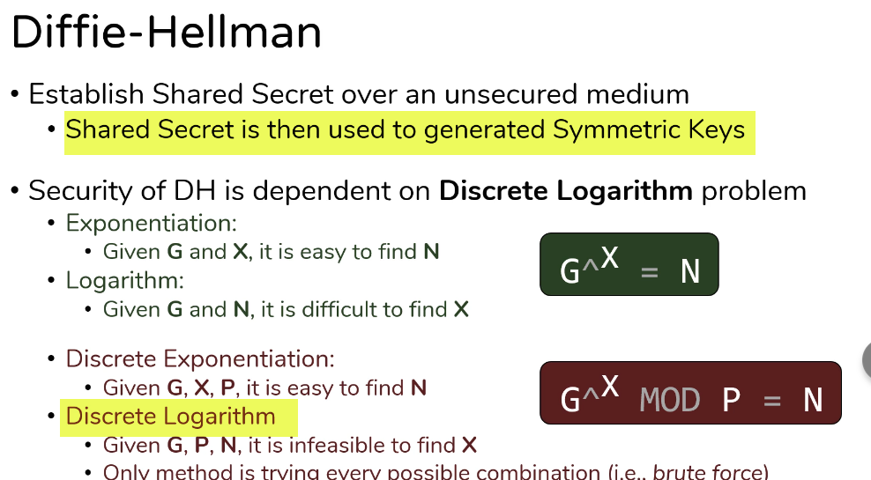
Used as secret key for HMAC

Slide 21
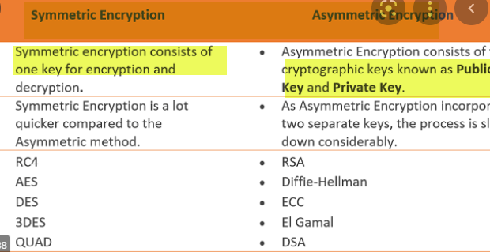
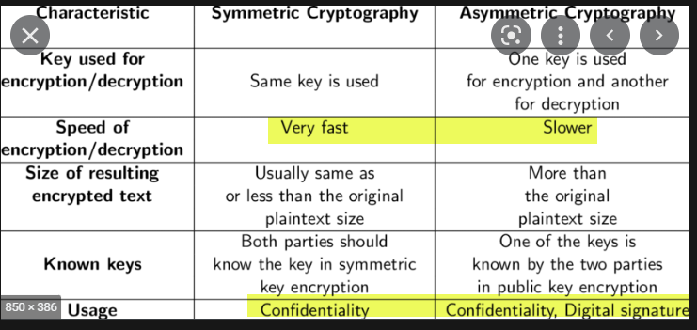
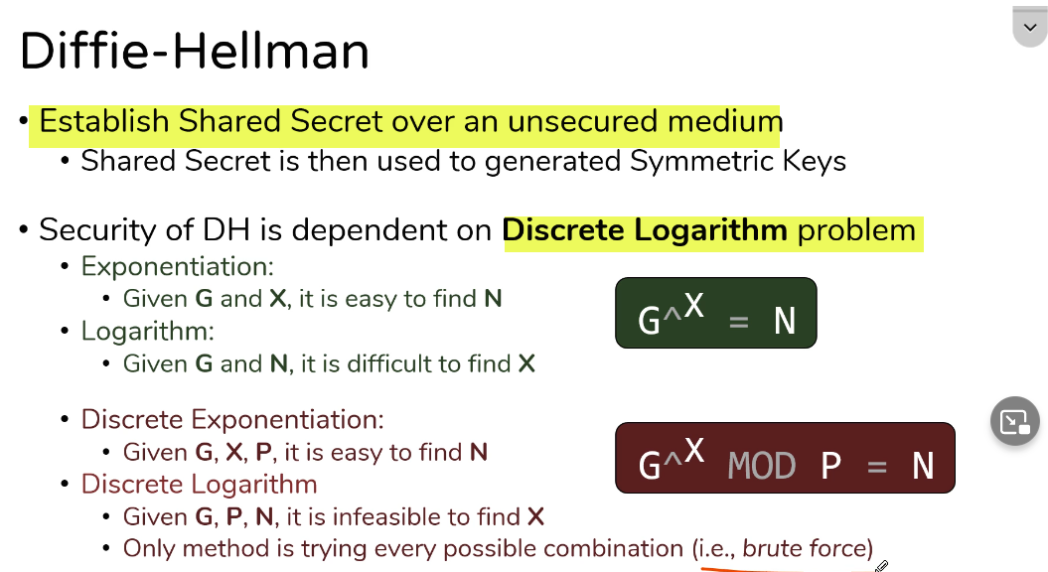
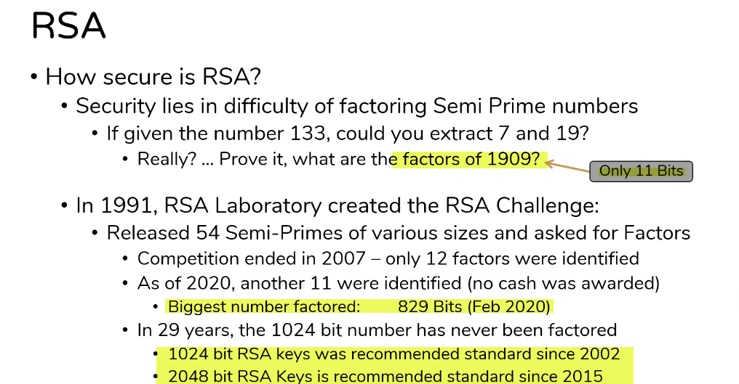

Slide 22
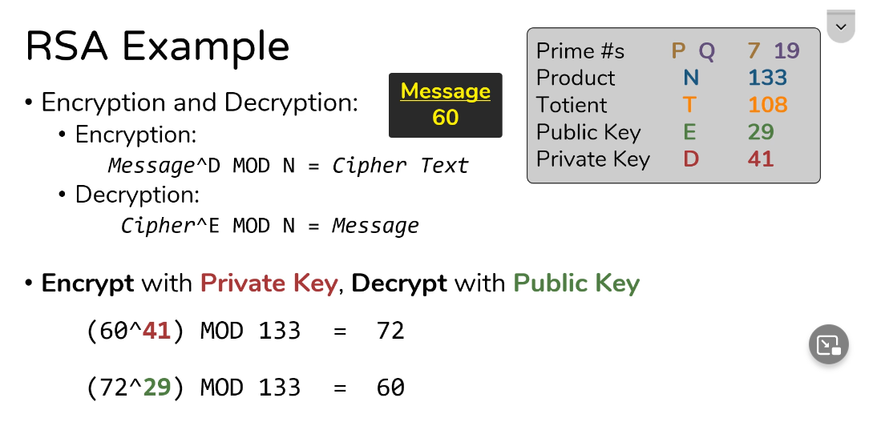
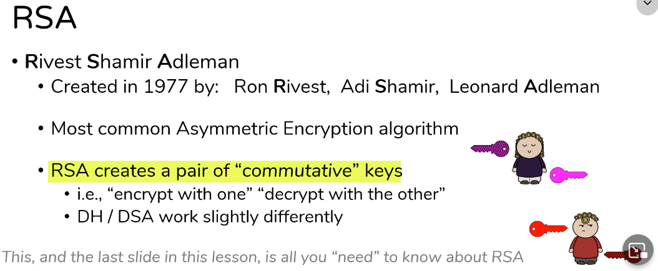

Slide 23
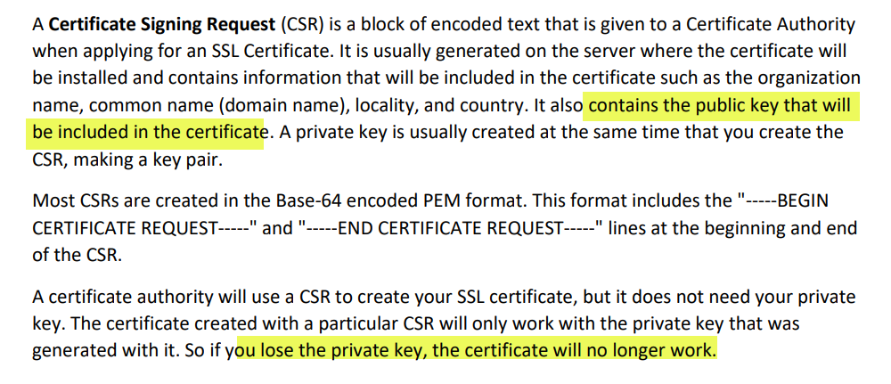
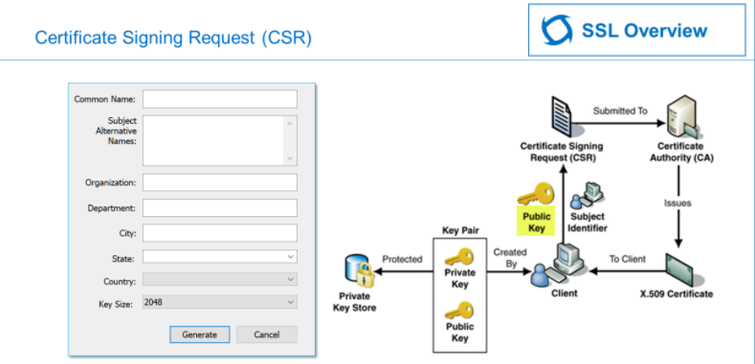

Slide 24
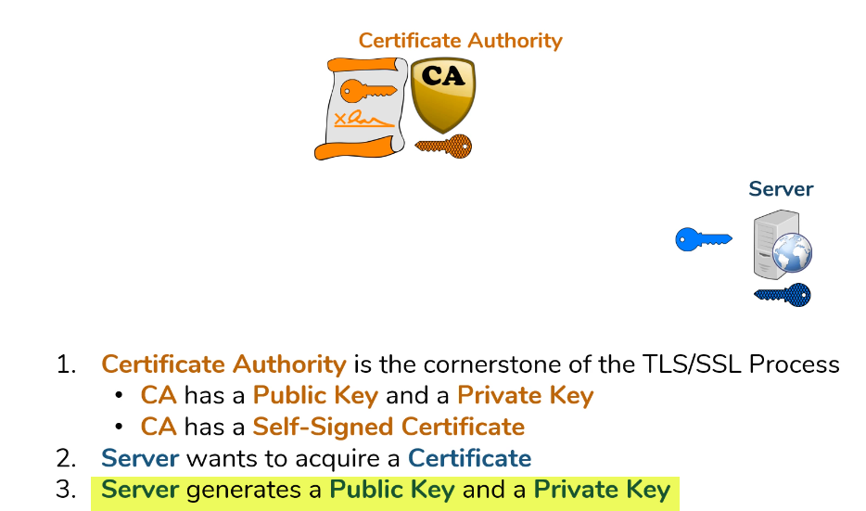
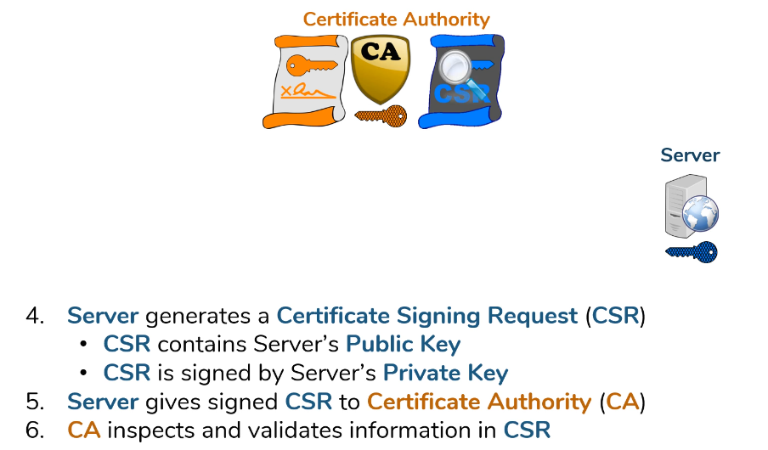
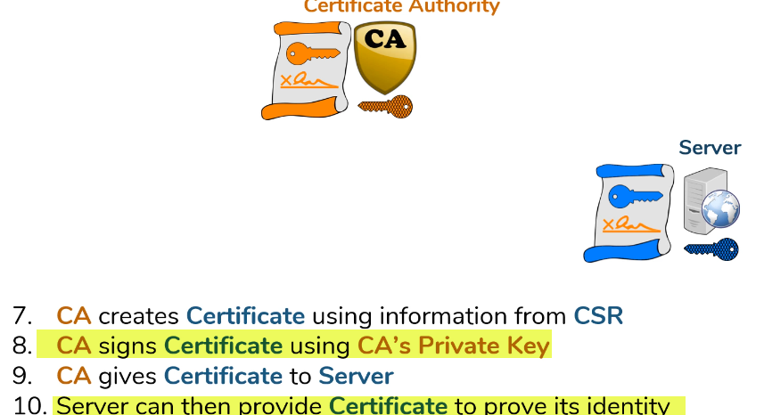
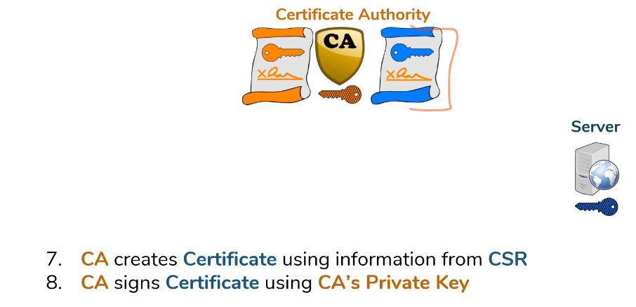

Slide 25
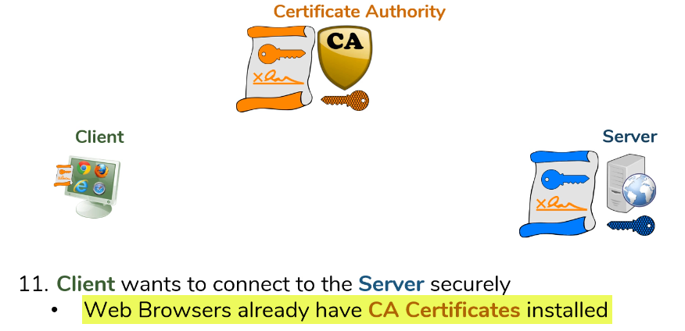

Slide 26
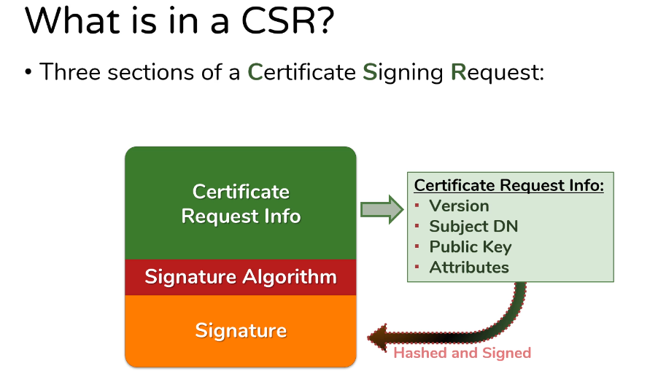
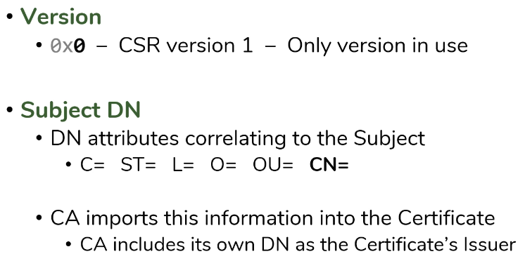
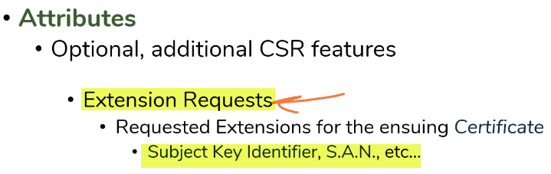
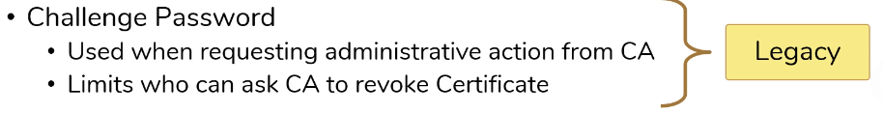


Slide 27



Slide 28




Slide 29


Slide 31


Slide 32




Slide 33


Slide 34


Slide 35


Slide 36



Slide 37



Slide 38




Slide 39


Slide 40



Slide 41


Slide 42


Slide 43


Slide 44


Slide 45



Slide 46



Slide 47


Slide 48


Slide 49


Slide 50


Slide 51



Slide 52


Slide 53


Slide 54



Slide 55



Slide 56


Slide 57


Slide 58



Slide 59


Slide 60


Slide 61


Slide 64

Initializing a connection in SSH consists of:
• Negotiating the version of the protocol to use
• Negotiating cryptographic algorithms and other options to use
• Negotiating a one-time session key for encrypting the rest of the session
• Authenticating the server host using its host key
• Authenticating the user using a password, public key authentication, or other means.
After this, data can be exchanged, including terminal data, graphics, and files.

Slide 65


Slide 66


